Slide 1


Prediction of BA
Mohd Munasib

Slide 2
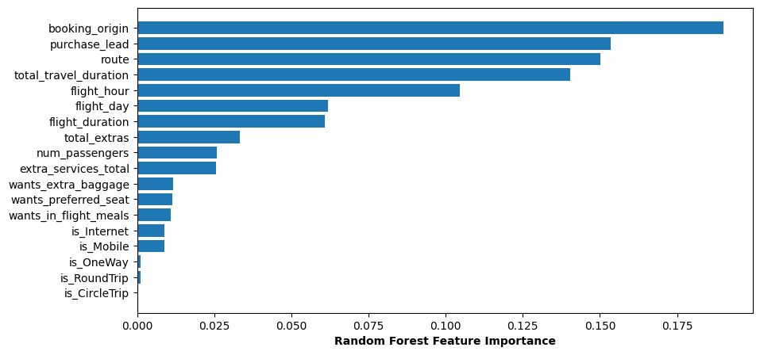

Slide 3
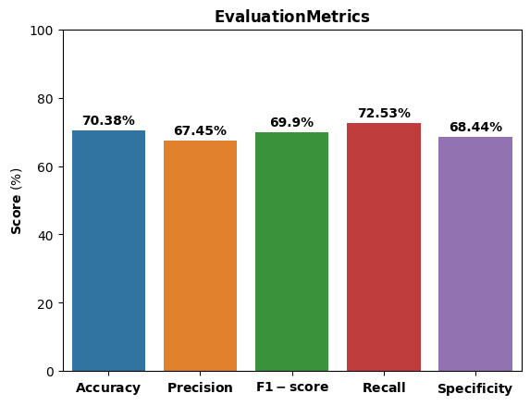

Slide 4
